Slide 1
Airbnb Price Prediction
Group Members:
Karan Bari
Mehak Shamsi
Rohit Samant

Slide 2
Project Introduction
The topic we have touched over here is the most fast growing service that is being used today “Airbnb”.
Airbnb is an online marketplace which lets people rent out their properties or spare rooms to guests.

Slide 3
Project Description
The data consists of Airbnb listings of cities-NYC, SF, DC, LA, CHICAGO, BOSTON of the USA.
The dataset has 74,111 rows and 29 features which are continuous and categorical.
The data contains the attributes id, property_type, room_type, amenities, accommodations, bathrooms, bed_type, cancellation_policy, cleaning_fee, city, description, first_review, host_has_profile_pic, host_identity_verified, host_response_rate, host_since, instant_bookable, last_review, latitude, longitude, name, neighbourhood, number_of_reviews, review_scores_rating, thumbnail_url, zipcode, bedrooms, beds.

Slide 4
Problem Statement
Guests often face a problem of unfair pricing and this can be due to a number of reasons like seasonal rush, abrupt booking cancellations, hosts preferences etc.
We propose to analyse Airbnb’s publicly available listing information to try and validate our hypotheses to address some of those issues.
To predict prices of Airbnb listings with the help of Regression techniques.

Slide 5
Idea behind the Project
This project analyses Airbnb listings major cities of the U.S.A to better understand how different attributes such as bedrooms, location, house type amongst others can be used to accurately predict the price of a new listing that is optimal in terms of the host’s profitability yet affordable to their guests.
This model is intended to be helpful to the internal pricing tools that Airbnb provides to its hosts.

Slide 6
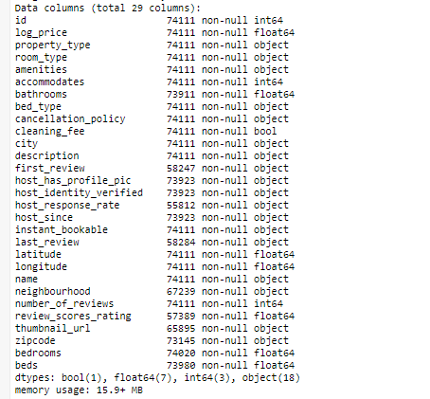
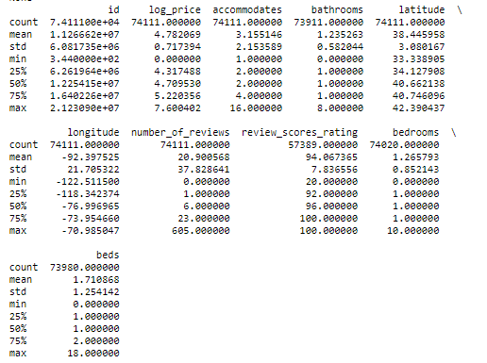
Dataset & Analysis

Slide 7
Workflow
Formation of Hypothesis.
Data Cleaning.
EDA and Visualisations.
Feature Engineering.
Defining the evaluation criteria.
Model Building.
Tuning the model.

Slide 8
Future Scope and References
Future scope to be decided as we start our working in the project and in the end come to a common conclusion.
Ref- https://www.kaggle.com/rudymizrahi/airbnb-listings-in-major-us-cities-deloitte-ml#test.csv

Slide 9
Thank You

